Slide 1
Applied Studies - Food & Textiles Technology
Year 8

Slide 2
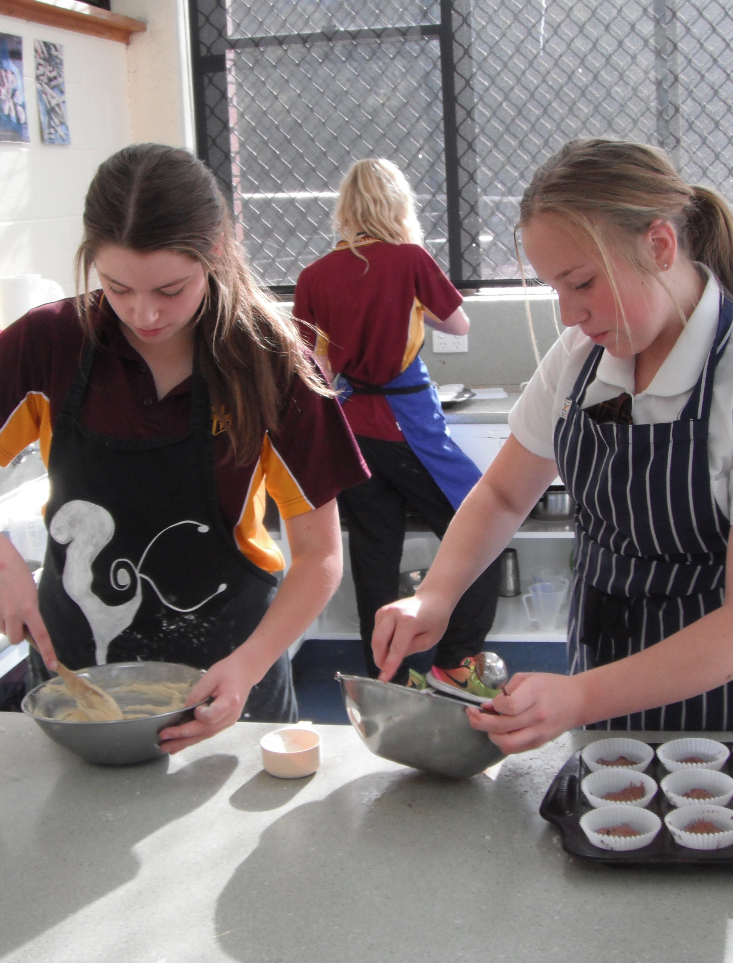
Food & Textiles Technology
1 year course
3 Terms of Cooking and 1 Term of Textiles
Design challenges:
Textiles, Baking, Meal solutions

Slide 3
Food & Textiles Technology
Expand on skills learnt in Year 7 about safety, hygiene and equipment
Learn to operate a sewing machine
Learn to use tools and equipment used for baking and making meals

Slide 4
Find out more…
Please feel free to contact Mrs Selina Kinne, Head of Technology and Applied Studies, at skinne@dominic.tas.edu.au

